Slide 1
Self-Organizing Map using IVC Characters
Austin Gay, Rishitha Mulagolla

Slide 2
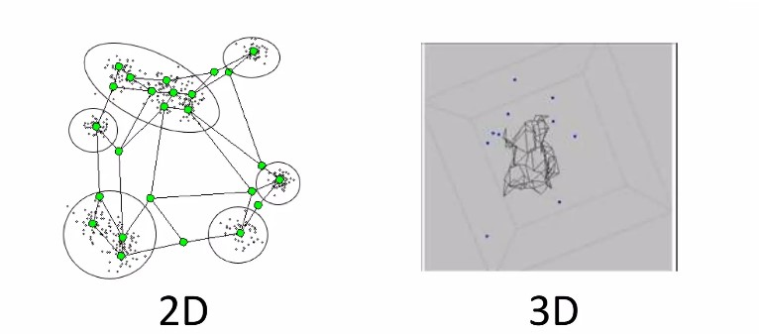
What is SOM?
It is an unsupervised machine learning technique used to produce a low dimensional representation of a higher dimensional data set while preserving topological information of the data.
Self-organizing map also known as kohonen map.
This model was first described as an artificial neural network (ANN) by professor Teuvo Kohonen.
An SOM is a type of ANN but is trained using Competitive learning rather than the error-correction learning.

Slide 3
Self Organizing Map Method

Slide 4
Initialize SOM
Initialize SOM (n, m, # of features) nodes with random variables
In our case we initialized with random variables in a range of 0 to 1
Images are 28 by 28 = 784 features
Example:
n = 10
m = 10
features = 784
SOM: (10, 10, 784)
Fill with random variables ranging from 0 to 1

Slide 5
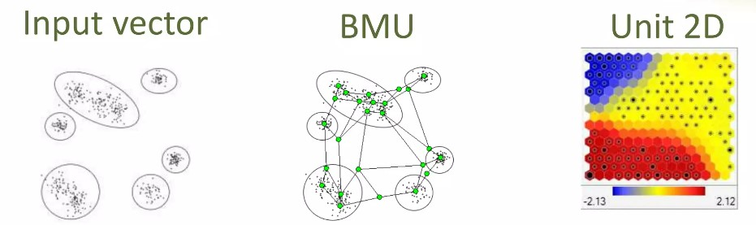
Best Matching Unit
The chosen node, the Best Matching Unit (BMU), is selected according to the similarity, between the current input values and all the nodes in the grid.
The node with the smallest Euclidean difference between the input vector and all nodes is chosen, along with its neighbouring nodes within a certain radius, to have their position slightly adjusted to match the input vector.By going through all the nodes present on the grid,
the entire grid eventually matches the complete input dataset, with similar nodes grouped together towards one area, and dissimilar ones separated.

Slide 6


Update the Weight Vectors of SOM Nodes
Update the weight of the BMU and it’s neighboring nodes
Maximum change occurs in the BMU
Impact decreases as you move away from the BMU
t is the epoch number
(g,h) are the coordinates of BMU
η is the learning rate
σt is the radius
fij(g,h,σt) is the neighborhood distance function

Slide 7
Data

Slide 8
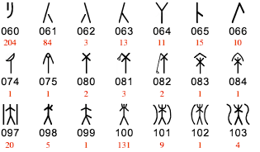
IVC Characters dataset:
The IVC, Indus Valley Civilization, was a civilization located in the Northwestern regions of South Asia between 3300 BCE and 1300 BCE. Selected characters from this dataset are used to train the Self-Organizing Map. Roughly 100 characters were selected.

Slide 9
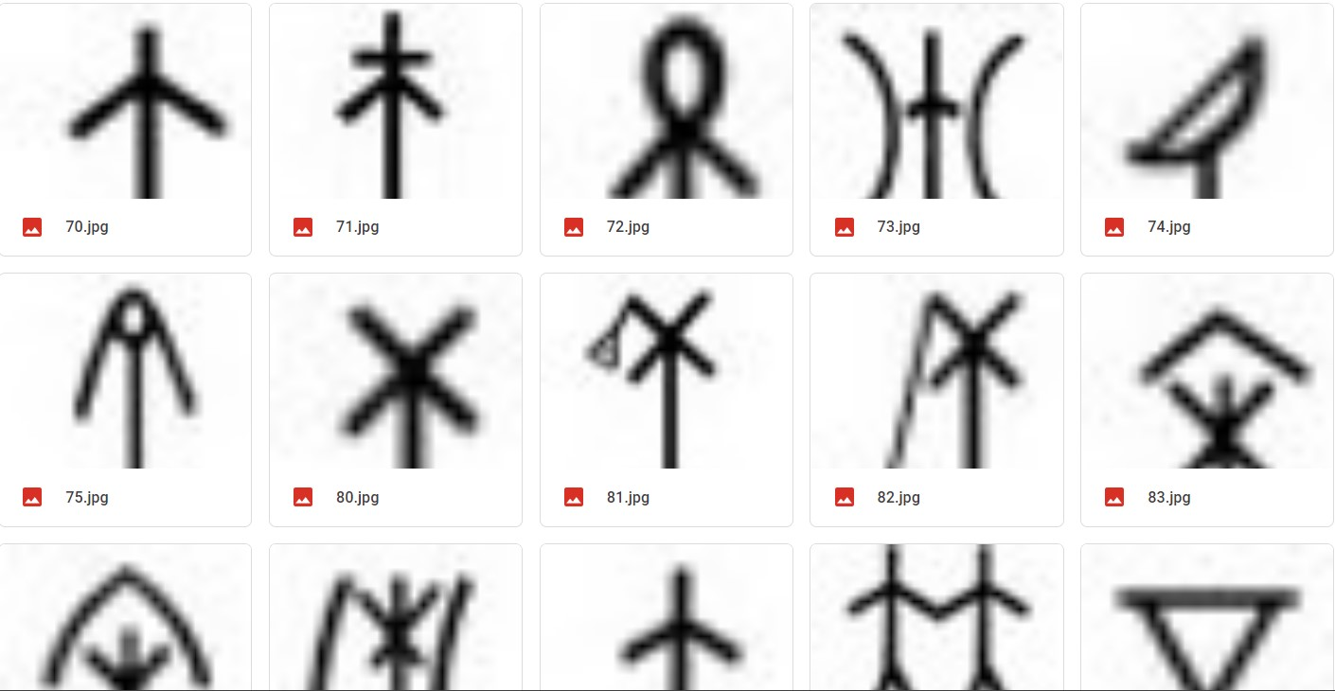
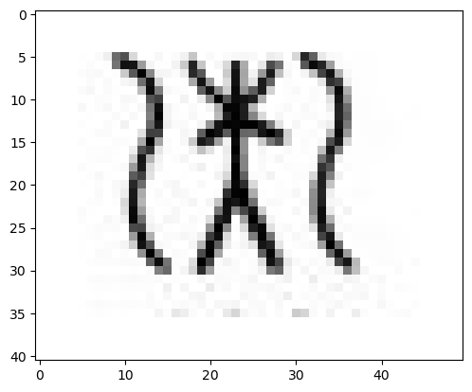
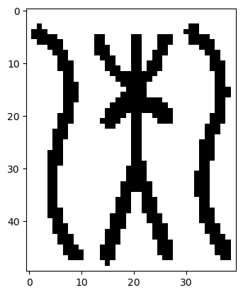
IVC Characters dataset:
Data Preparation
Save screenshots to a folder
Crop each image to remove the amount of blank space
Resize images to the same size (40 x 50 pixels)
Image Enhancement
Smoothing Filter
Edge Enhancing Filter
Binarizing (Thresholding)

Slide 10
Results

Slide 11
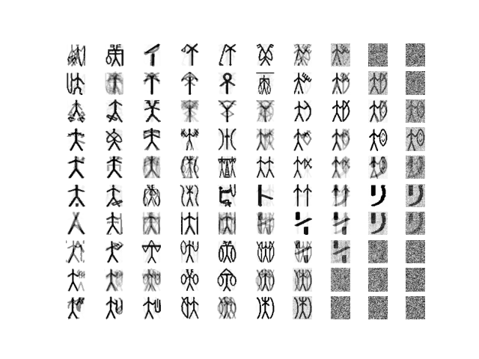
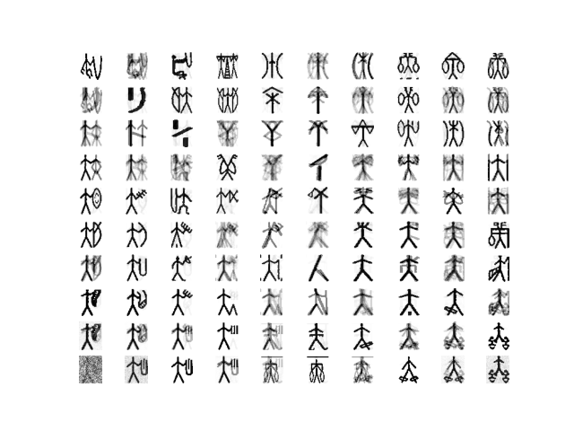
10 x 10 SOM
Results of the 10 x 10 SOM
Characters with similar shapes in same region of SOM
10 by 10 too large for dataset

Slide 12
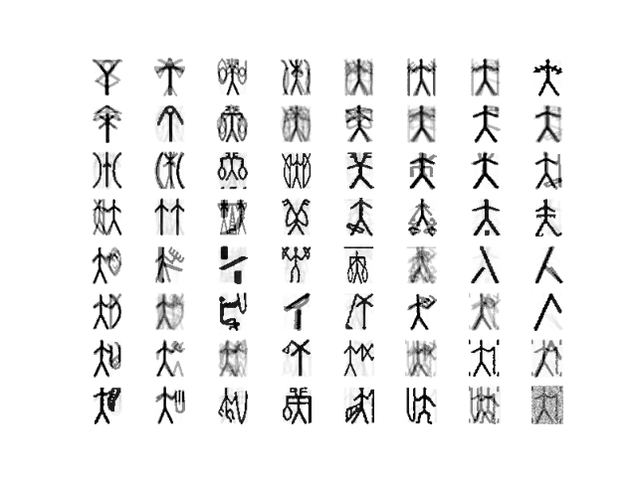
8 x 8 SOM
Slightly condensed from the 10 x 10 Map

Slide 13
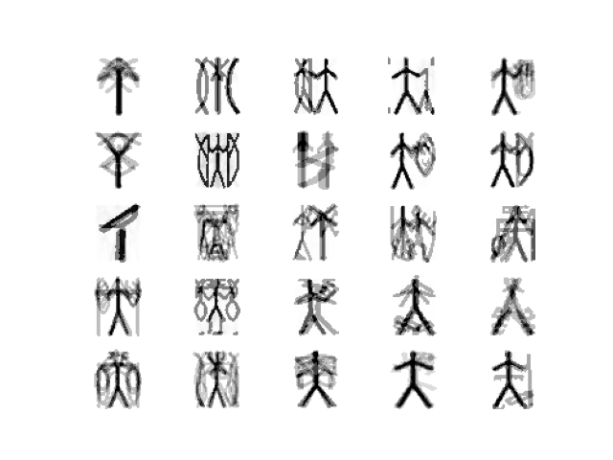
5 x 5 SOM
Clearly defined primary shape of characters
Lighter secondary features
Each node contains characteristics of several different IVC characters

Slide 14
Resources
https://en.wikipedia.org/wiki/Self-organizing_map
https://towardsdatascience.com/kohonen-self-organizing-maps-a29040d688da
https://stackabuse.com/self-organizing-maps-theory-and-implementation-in-python-with-numpy/
https://en.wikipedia.org/wiki/MNIST_database
https://iust-projects.ir/post/ann03/
https://towardsdatascience.com/understanding-self-organising-map-neural-network-with-python-code-7a77f501e985

